Slide 1
Classification of tumors into 2 categories (benign or malignant) based on features of tumor cell nuclei
Rehan Ali

Slide 2
Problem
Is a tumor malignant or benign?
 | diagnosis | radius_mean | texture_mean | perimeter_mean | area_mean | smoothness_mean | compactness_mean | concavity_mean | concave points_mean | symmetry_mean | ... | texture_worst | perimeter_worst | area_worst | smoothness_worst | compactness_worst | concavity_worst | concave points_worst | symmetry_worst | fractal_dimension_worst | Unnamed: 32
id
842302 | M | 17.99 | 10.38 | 122.80 | 1001.0 | 0.11840 | 0.27760 | 0.3001 | 0.14710 | 0.2419 | ... | 17.33 | 184.60 | 2019.0 | 0.1622 | 0.6656 | 0.7119 | 0.2654 | 0.4601 | 0.11890 | NaN
842517 | M | 20.57 | 17.77 | 132.90 | 1326.0 | 0.08474 | 0.07864 | 0.0869 | 0.07017 | 0.1812 | ... | 23.41 | 158.80 | 1956.0 | 0.1238 | 0.1866 | 0.2416 | 0.1860 | 0.2750 | 0.08902 | NaN
84300903 | M | 19.69 | 21.25 | 130.00 | 1203.0 | 0.10960 | 0.15990 | 0.1974 | 0.12790 | 0.2069 | ... | 25.53 | 152.50 | 1709.0 | 0.1444 | 0.4245 | 0.4504 | 0.2430 | 0.3613 | 0.08758 | NaN
84348301 | M | 11.42 | 20.38 | 77.58 | 386.1 | 0.14250 | 0.28390 | 0.2414 | 0.10520 | 0.2597 | ... | 26.50 | 98.87 | 567.7 | 0.2098 | 0.8663 | 0.6869 | 0.2575 | 0.6638 | 0.17300 | NaN
84358402 | M | 20.29 | 14.34 | 135.10 | 1297.0 | 0.10030 | 0.13280 | 0.1980 | 0.10430 | 0.1809 | ... | 16.67 | 152.20 | 1575.0 | 0.1374 | 0.2050 | 0.4000 | 0.1625 | 0.2364 | 0.07678 | NaN

Slide 3
Data
Features
Target variable
 | diagnosis | radius_mean | texture_mean | perimeter_mean | area_mean | smoothness_mean | compactness_mean | concavity_mean | concave points_mean | symmetry_mean | ... | texture_worst | perimeter_worst | area_worst | smoothness_worst | compactness_worst | concavity_worst | concave points_worst | symmetry_worst | fractal_dimension_worst | Unnamed: 32
id
842302 | M | 17.99 | 10.38 | 122.80 | 1001.0 | 0.11840 | 0.27760 | 0.3001 | 0.14710 | 0.2419 | ... | 17.33 | 184.60 | 2019.0 | 0.1622 | 0.6656 | 0.7119 | 0.2654 | 0.4601 | 0.11890 | NaN
842517 | M | 20.57 | 17.77 | 132.90 | 1326.0 | 0.08474 | 0.07864 | 0.0869 | 0.07017 | 0.1812 | ... | 23.41 | 158.80 | 1956.0 | 0.1238 | 0.1866 | 0.2416 | 0.1860 | 0.2750 | 0.08902 | NaN
84300903 | M | 19.69 | 21.25 | 130.00 | 1203.0 | 0.10960 | 0.15990 | 0.1974 | 0.12790 | 0.2069 | ... | 25.53 | 152.50 | 1709.0 | 0.1444 | 0.4245 | 0.4504 | 0.2430 | 0.3613 | 0.08758 | NaN
84348301 | M | 11.42 | 20.38 | 77.58 | 386.1 | 0.14250 | 0.28390 | 0.2414 | 0.10520 | 0.2597 | ... | 26.50 | 98.87 | 567.7 | 0.2098 | 0.8663 | 0.6869 | 0.2575 | 0.6638 | 0.17300 | NaN
84358402 | M | 20.29 | 14.34 | 135.10 | 1297.0 | 0.10030 | 0.13280 | 0.1980 | 0.10430 | 0.1809 | ... | 16.67 | 152.20 | 1575.0 | 0.1374 | 0.2050 | 0.4000 | 0.1625 | 0.2364 | 0.07678 | NaN

Slide 4
Problem
Predict
Nuclei features
Tumor type
Why do we care?
Pathologists make a subjective judgement based on nuclei features.
Based on this judgement Oncologists recommend a treatment regime.
THEREFORE
Increasing accuracy of prediction by making it objective and automated, will improve prognosis and will accelerate decision making by pathologists.

Slide 5
Data wrangling
- Remove NaN column
df.drop('Unnamed: 32', axis=1, inplace = True)
- Check that no observations are repeated
assert df.index.value_counts().max() == 1
- See the notebook for the code for the following steps:
Remove unwanted columns
Normalize the data

Slide 6
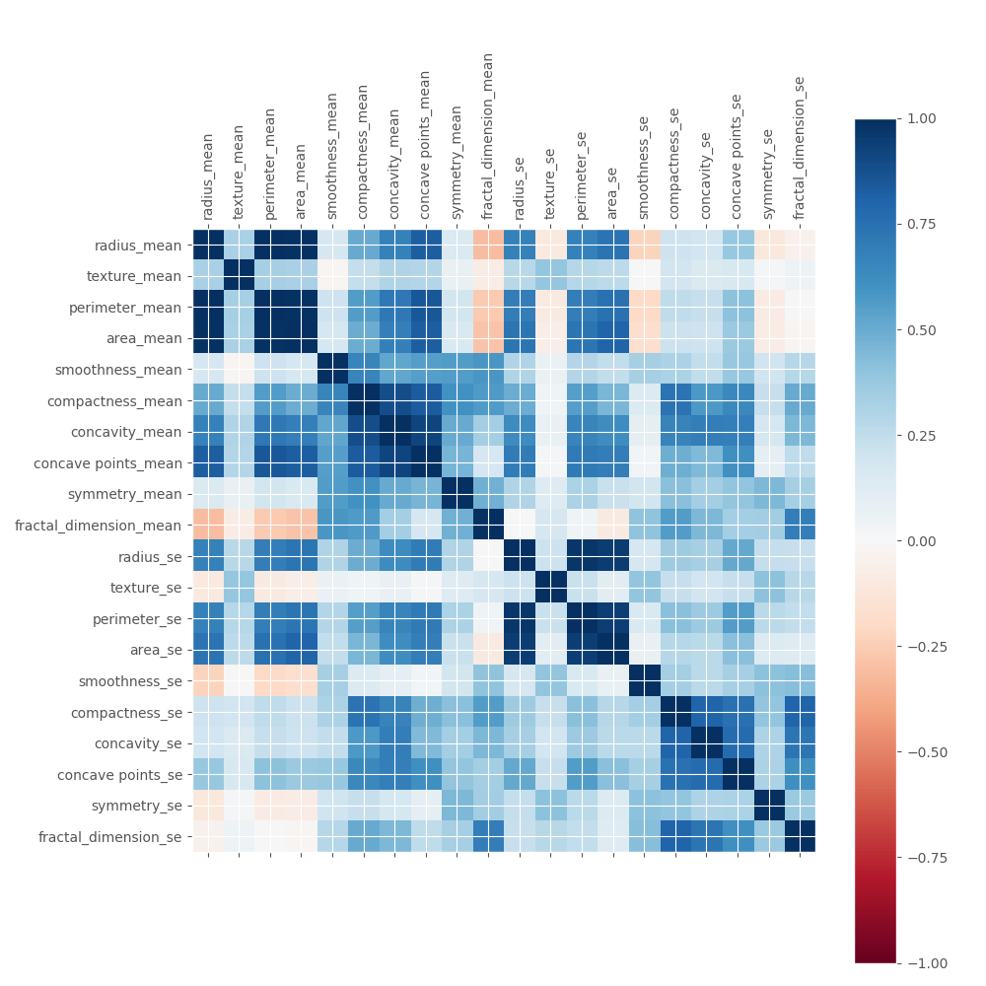
Exploratory data analysis
High correlation between radius, area and perimeter.
High correlation between compactness, concavity and number of concave points.

Slide 7
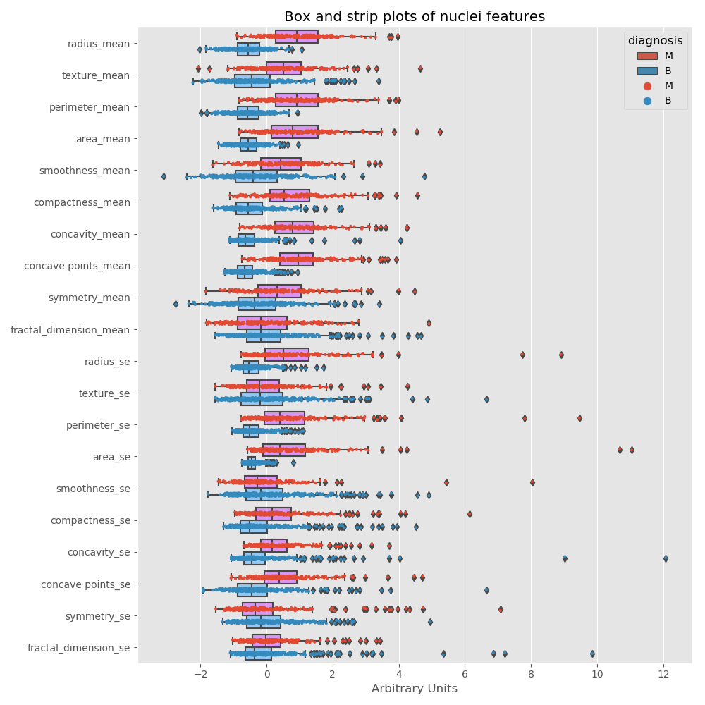
Exploratory data analysis
All features show an increase in malignant nuclei compared to benign nuclei

Slide 8
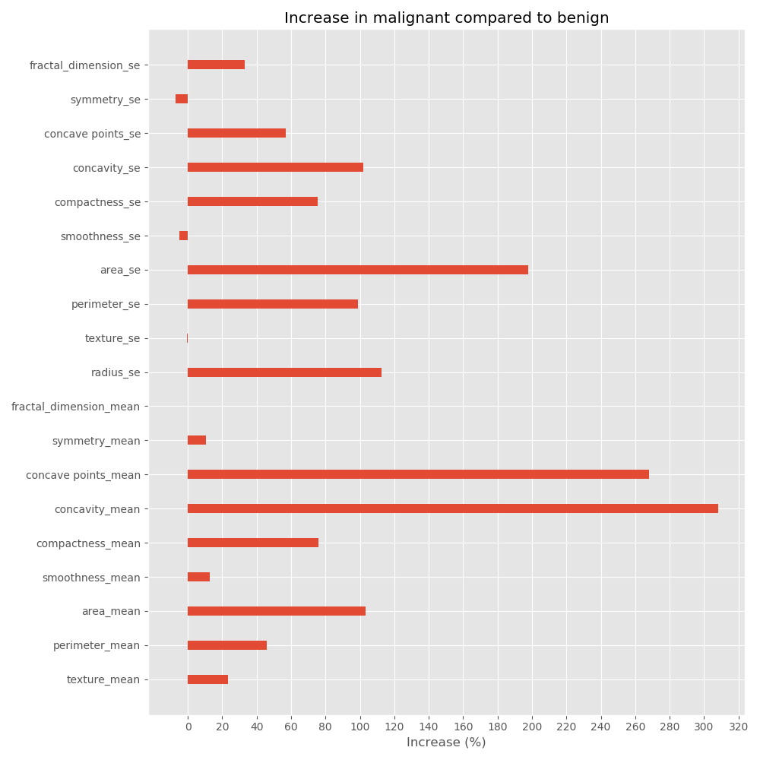
Exploratory data analysis
Largest changes are observed in the concavity, number of concave points and area of malignant nuclei compared to benign nuclei.

Slide 9
Exploratory data analysis
 | U_statistic | P_value
radius_mean | 70955.0 | 1.346471e-68
texture_mean | 58717.5 | 1.714313e-28
perimeter_mean | 71665.0 | 1.776935e-71
area_mean | 71015.5 | 7.698902e-69
smoothness_mean | 54647.0 | 3.896503e-19
compactness_mean | 65374.5 | 4.475996e-48
concavity_mean | 70978.5 | 1.082274e-68
concave points_mean | 72992.5 | 5.031619e-77
symmetry_mean | 52870.0 | 1.134025e-15
fractal_dimension_mean | 36671.5 | 7.315811e-01
radius_se | 65719.0 | 3.108570e-49
texture_se | 38719.5 | 3.218464e-01
perimeter_se | 66329.0 | 2.549719e-51
area_se | 70114.5 | 2.883912e-65
smoothness_se | 35483.5 | 8.932812e-01
compactness_se | 55043.5 | 5.840307e-20
concavity_se | 59095.5 | 1.837754e-29
concave points_se | 59926.0 | 1.185426e-31
symmetry_se | 33671.0 | 9.861004e-01
fractal_dimension_se | 46947.0 | 7.860827e-07
Normalcy test showed that none of the features follow a normal distribution Therefore, we need to use a non-parametric statistical test.
Low p-values from mann-whitney u-test for all the features suggest that there is a statistically significant difference in all the features.

Slide 10
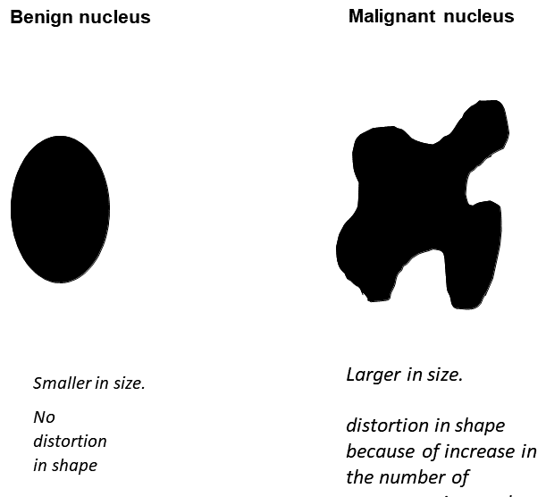
Visual model

Slide 11
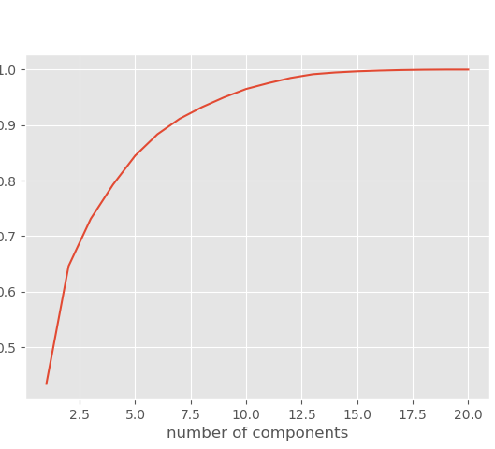
Machine learning models
Because of high correlation between features PCA needed to be performed.
PCA shows that 10 components explain more than 95% of the variance in the data.

Slide 12
Machine learning models k-nearest neighbors on PCA transformed data
The f-1 score for test data is 0.96.
K-NN models are slow to predict especially If the test data is large.
One cannot know the weight, different features in the data, have on predicting the class of tumors.

Slide 13
Machine learning models logistic regression on PCA transformed data
The f-1 score for test data is 0.97.
Logistic regression models are also fast to predict even If the test data is large.
One cannot know the weight, different features in the data, have on predicting the class of tumors.

Slide 14
Machine learning models logistic regression on non-PCA transformed data
The f-1 score for test data is 0.95.
Logistic regression models are also fast to predict even If the test data is large.
One knows the weight, different features in the data, have on predicting the class of tumors.

